Slide 1
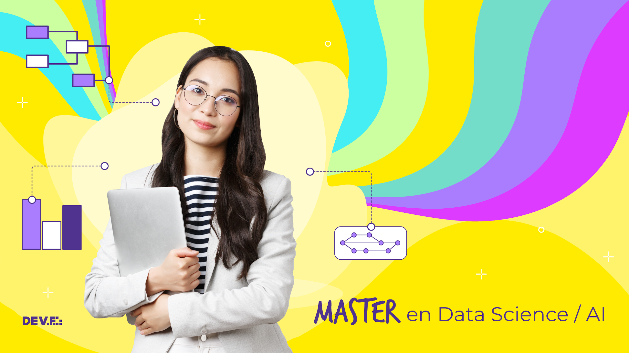

Slide 2

Agenda
6:30 - 6:35 PM Saludos y anuncios.
6:35 - 6:40 PM Objetivos.
6:40 - 7:00 PM Repaso de expectativas de trabajo.
7:00 - 7:10 PM Comentarios de primer ejercicio de clase pasada.
7:10 - 8:00 PM
Caso de estudio.
Proyecto 1: Mock up del entendimiento del negocio.
8:00 - 8:15 PM BREAK.
8:15 - 8:40 PM Challenge: Extracción de correos de Gmail.
8:40 - 9:20 PM Challenge: Limpieza de datos.
9:20 - 9:30 PM Conclusiones.

Slide 3
Módulo IX: Proyectos de Machine Learning.

Slide 4
Objetivos de la sesión
Repasar expectativa de trabajo para esta primer quincena.
Analizar un caso de estudio de recolección de datos.
Revisión de actividad en clase.
Iniciar mock up del entendimiento del negocio .
Iniciar mock up del scrapping

Slide 5
PRIMER SEMANA
 | MARZO
 | S1 |  | S2
ETAPAS | 8 | 10 | 15 | 17
Business Understanding
Determine Business Objectives
Background
Business Objectives
Business Success Criteria
Assess the Current Situation
Inventory of resources
Requirements, assumptions and constraints
Risks and contingencies
Terminology
Costs and benefits
Determine Data Mining Goals
Data Mining Goals
Data Mining Success Criteria
Produce Project Plan
Project Plan
Initial Assessment of Tools and Techniques
El día 1 vamos a estudiar un caso de estudio y:
Definiremos un problema a resolver.
Construiremos un dataset rápido para crear mejor empatía en el entendimiento del problema.
Discutiremos posibles ideas sobre desarrollo de proyecto.

Slide 6
PRIMER SEMANA
 | MARZO
 | S1 |  | S2
ETAPAS | 8 | 10 | 15 | 17
Business Understanding
Determine Business Objectives
Background
Business Objectives
Business Success Criteria
Assess the Current Situation
Inventory of resources
Requirements, assumptions and constraints
Risks and contingencies
Terminology
Costs and benefits
Determine Data Mining Goals
Data Mining Goals
Data Mining Success Criteria
Produce Project Plan
Project Plan
Initial Assessment of Tools and Techniques
El día 2 presentaremos nuestro proyecto de interés y los primeros descubrimientos:
Presentaremos la pregunta que queremos contestar.
Expondremos el análisis correspondiente al “Entendimiento del Negocio”.
Expondremos nuestro primer prototipo del entendimiento de los datos producidos.
Data Understanding
Collect Initial Data
Initial Data Collection Report
Describe Data
Initial Data Exploration
Verify Data Quality
Missing Data
Outliers
Data Quality Report

Slide 7
SEGUNDA SEMANA
 | MARZO
 | S1 |  | S2
ETAPAS | 8 | 10 | 15 | 17
Data Understanding
Collect Initial Data
Initial Data Collection Report
Describe Data
Initial Data Exploration
Verify Data Quality
Missing Data
Outliers
Data Quality Report
El día 3 presentaremos el entendimiento final de nuestros datos producidos.
Presentaremos nuestros descubrimientos.
Crearemos documentación sobre los datos para que alguien más pueda producir un modelo de predicción.
Expondremos los riesgos o potenciales riesgos que podrían expresarse si crearamos un modelo de predicción.

Slide 8
SEGUNDA SEMANA
El día 4 cerraremos con los demos.
Cada persona podrá para exponer todo lo que realizó en estas 2 semanas.
Intercambiaremos nuestro dataset y produciremos un modelo de predicción con el dataset recibido.
 | MARZO
 | S1 |  | S2
ETAPAS | 8 | 10 | 15 | 17
Demo
Presentación
Demo de modelado

Slide 9
¿Cómo nos fue en la primera actividad?

Slide 10
Los proyectos son problemáticos y no secuenciales
Quiero entender el comportamiento de mis gatos

Slide 11
Caso de estudio
Entendiendo el comportamiento de nuestras mascotas

Slide 12
Overview
Objectives and main deliverables.

Slide 13
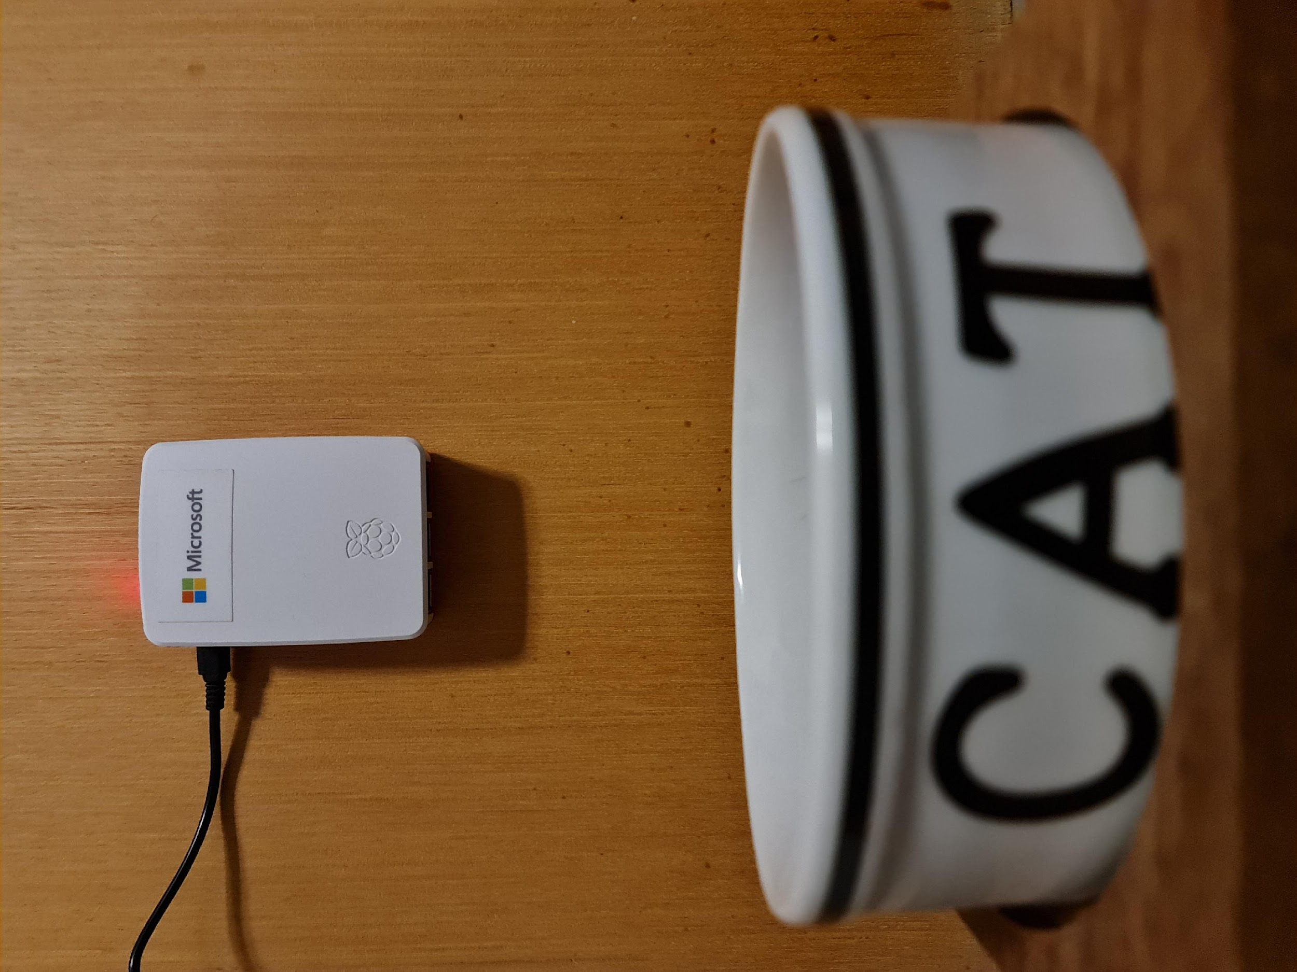
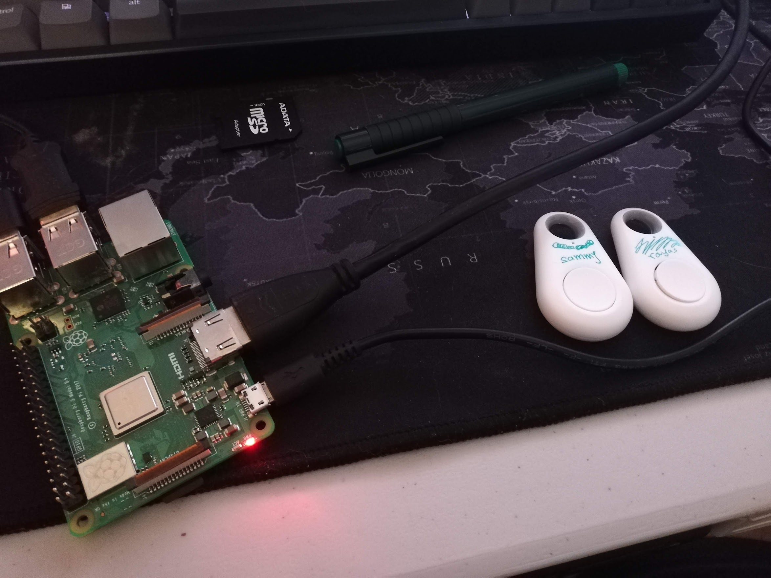
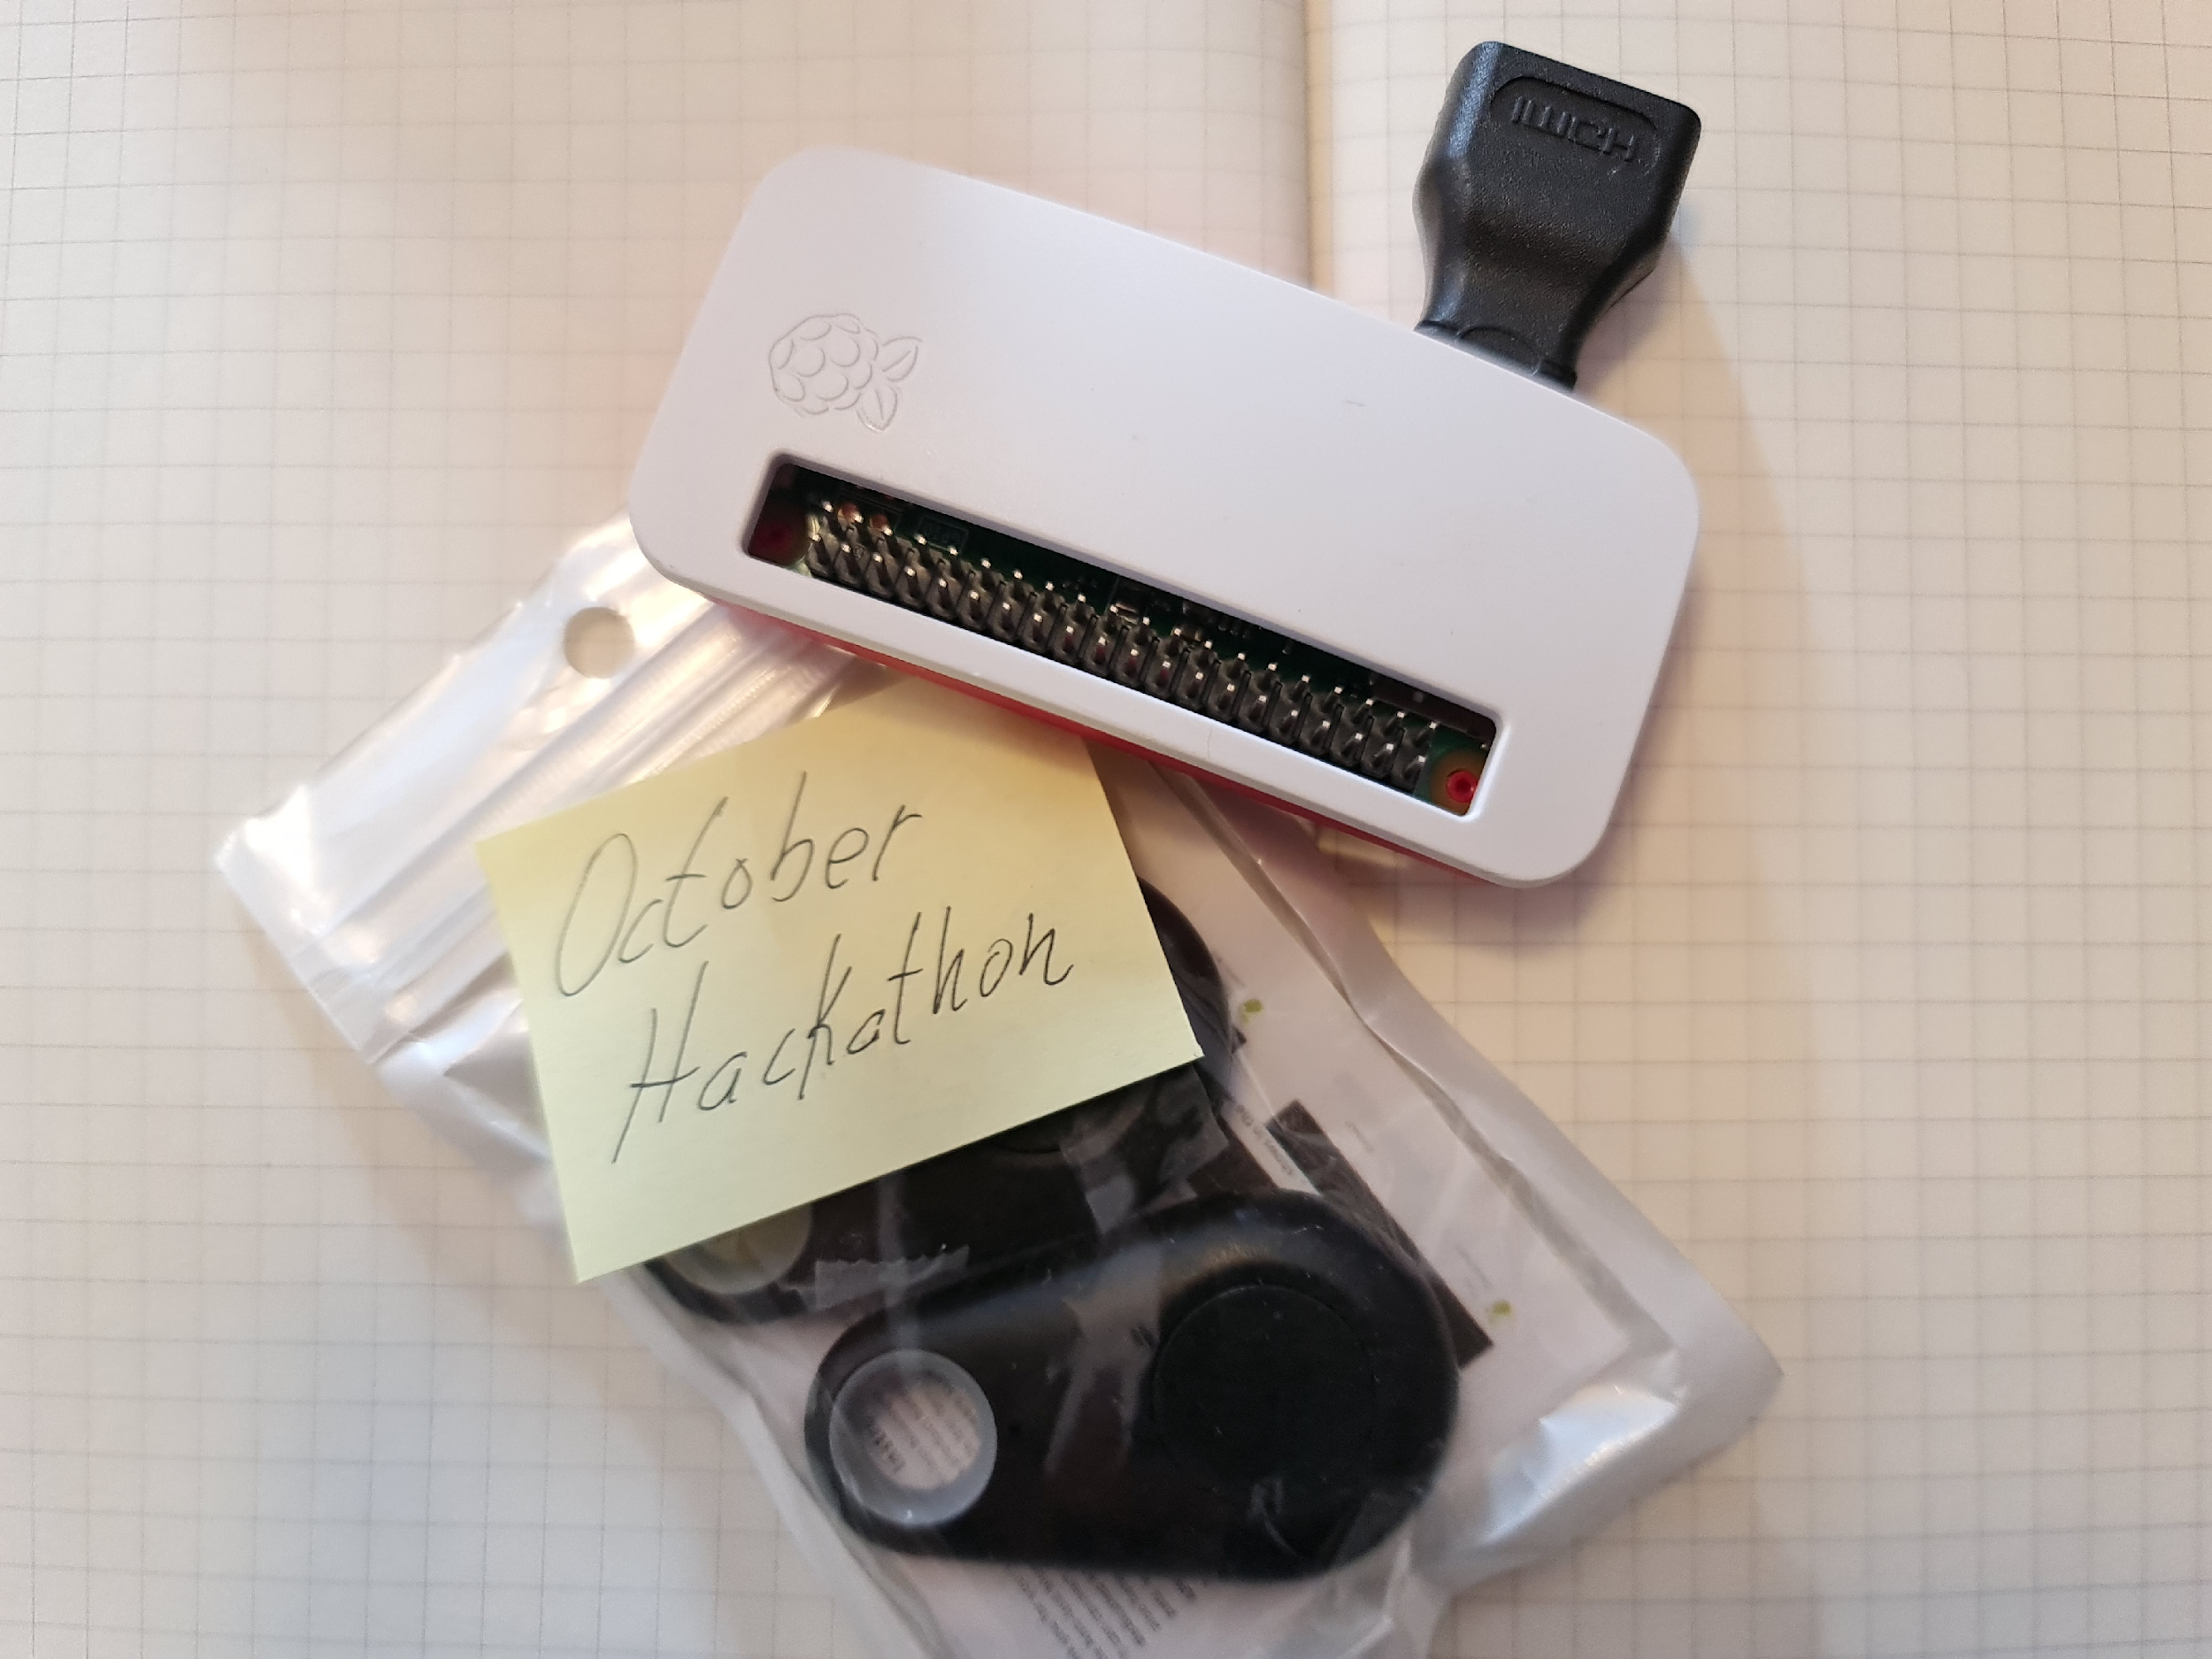
Indoor Feline Behavior
A Raspberry Pi tracking food consumption.
In this project, we built beacons with Raspberry Pi, and put them in strategic locations around the house. Then, we empowered our cats with Bluetooth LE tags. The beacons detect the cats' movements and send them to Azure's Cosmos DB. We can then plot and analyze their behavior with Microsoft technologies such as Power BI and Azure ML.

Slide 14
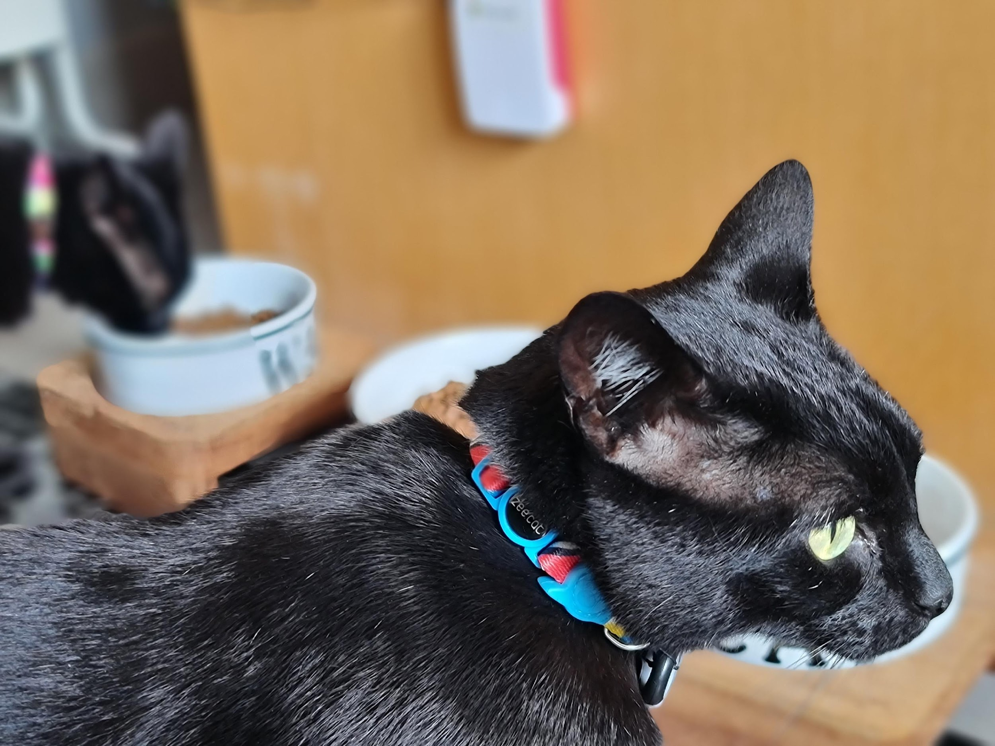
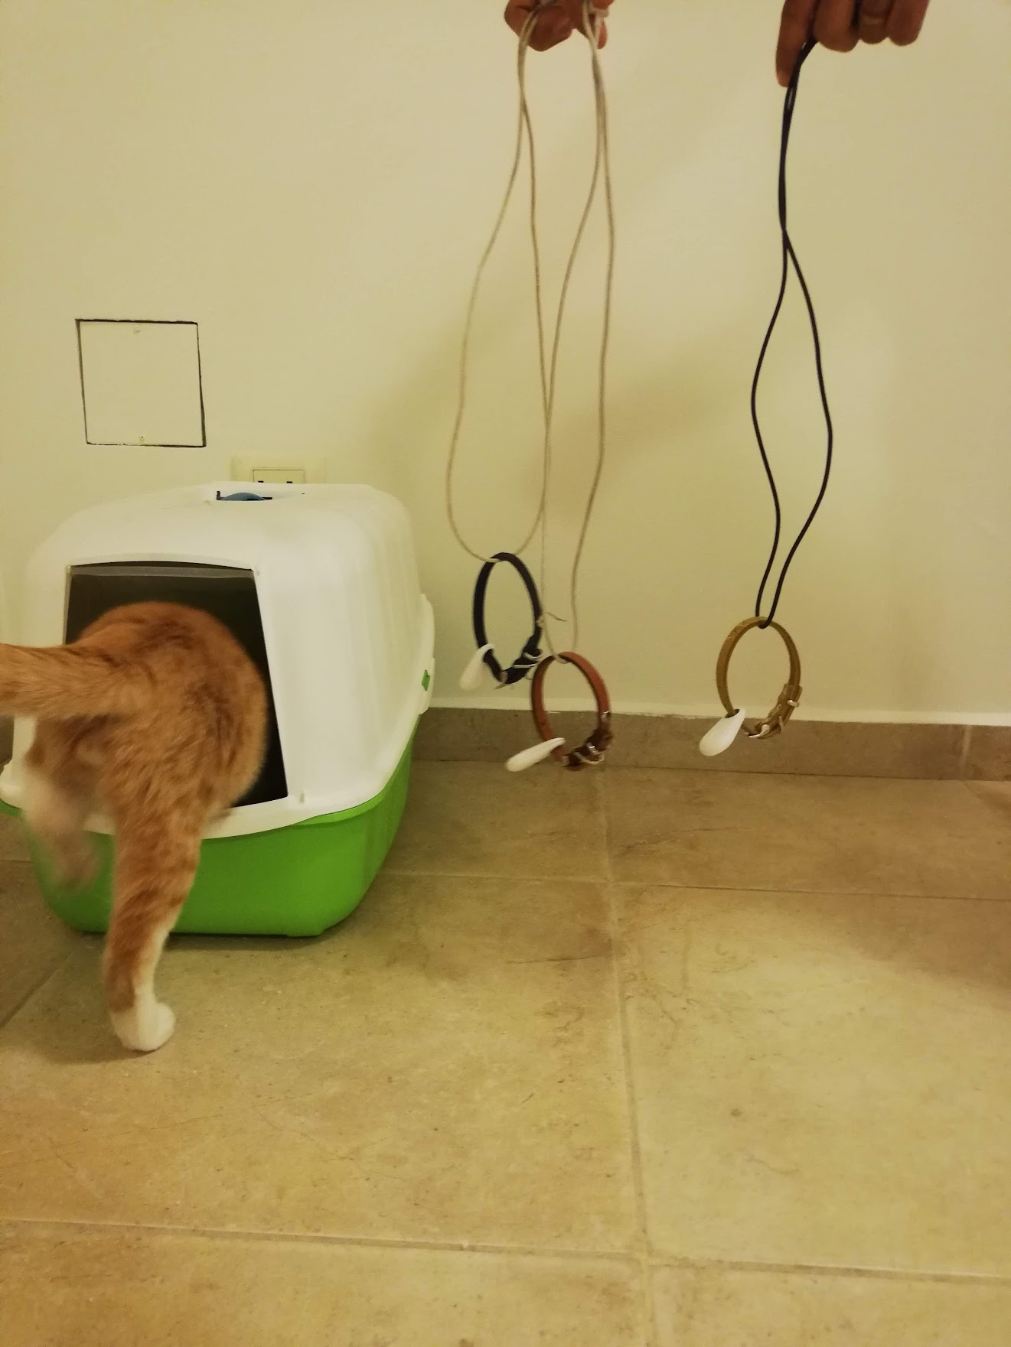
But WHY?!
Can you constantly monitor what your naughty cat is doing around the house, and understand what that means for your beloved pet's well-being and health?
Is he or she:
having enough water (super important for cats) and food? using the litter box?
getting exercise?
changing routine? You might not know, but cats do get depressed.
leaving the house, much to your despair?!
Also, food disappears, but maybe it is just one of your 3 cats that eats everything?
And what if you could actually predict what these formerly wild animals will do?
Guess what, you need data for all of this!

Slide 15

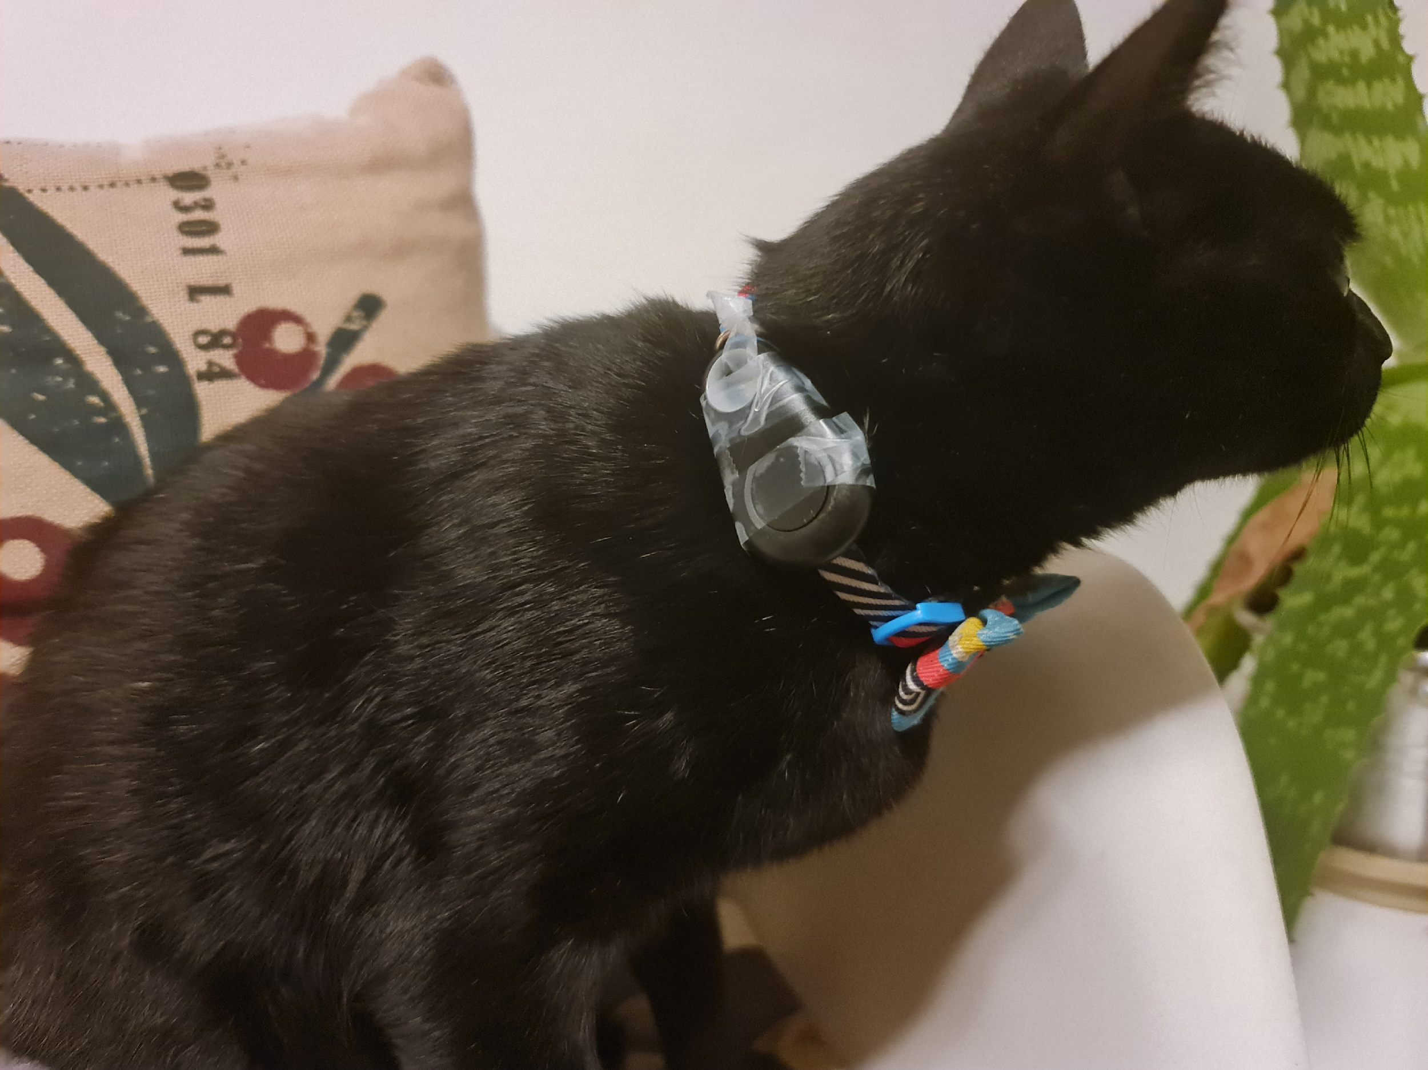
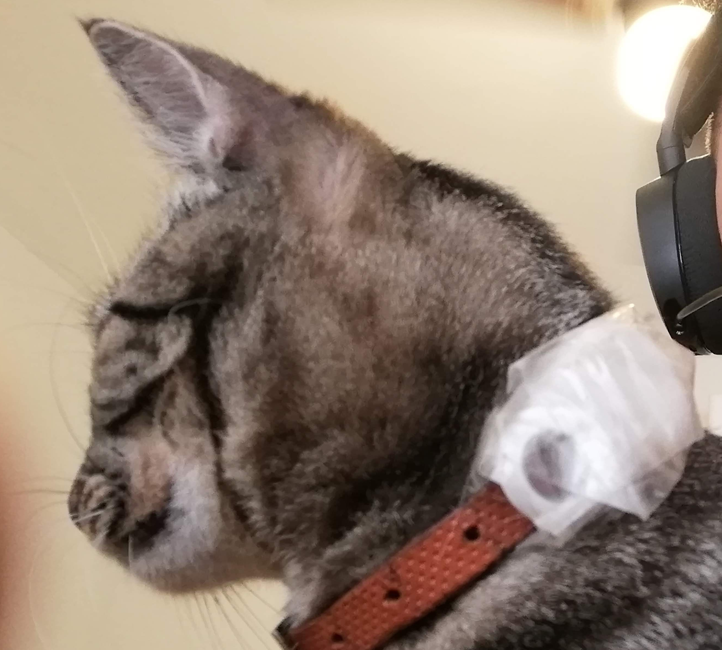
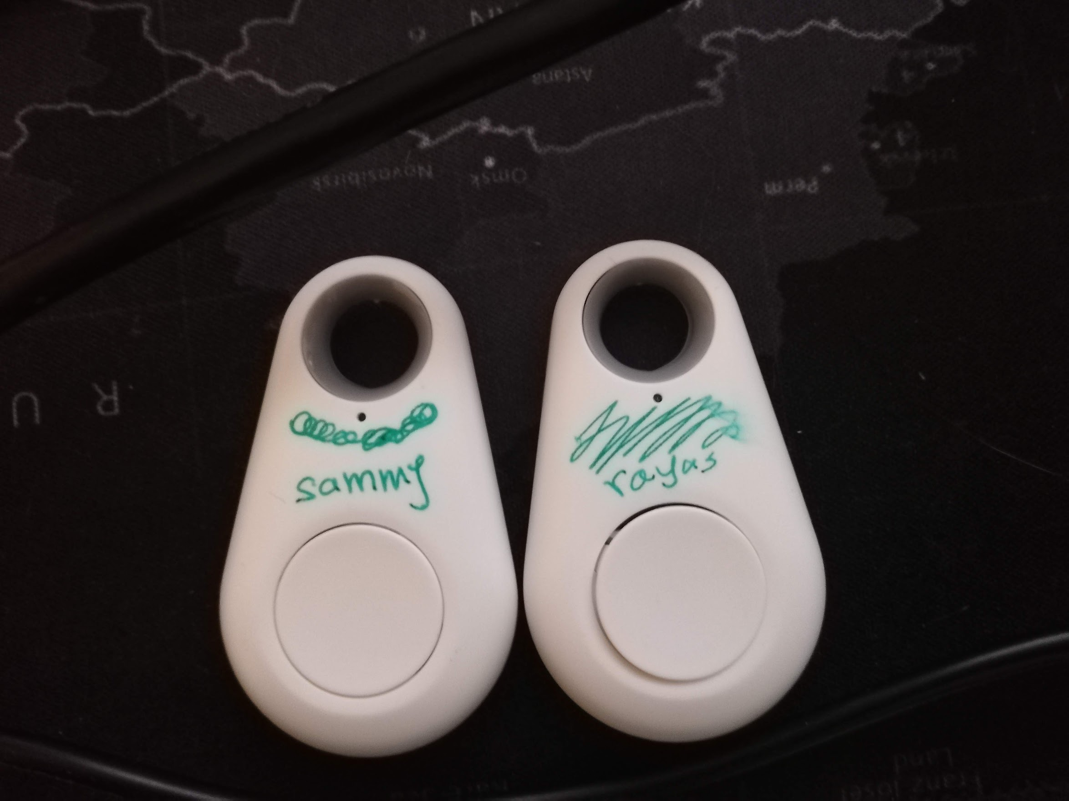
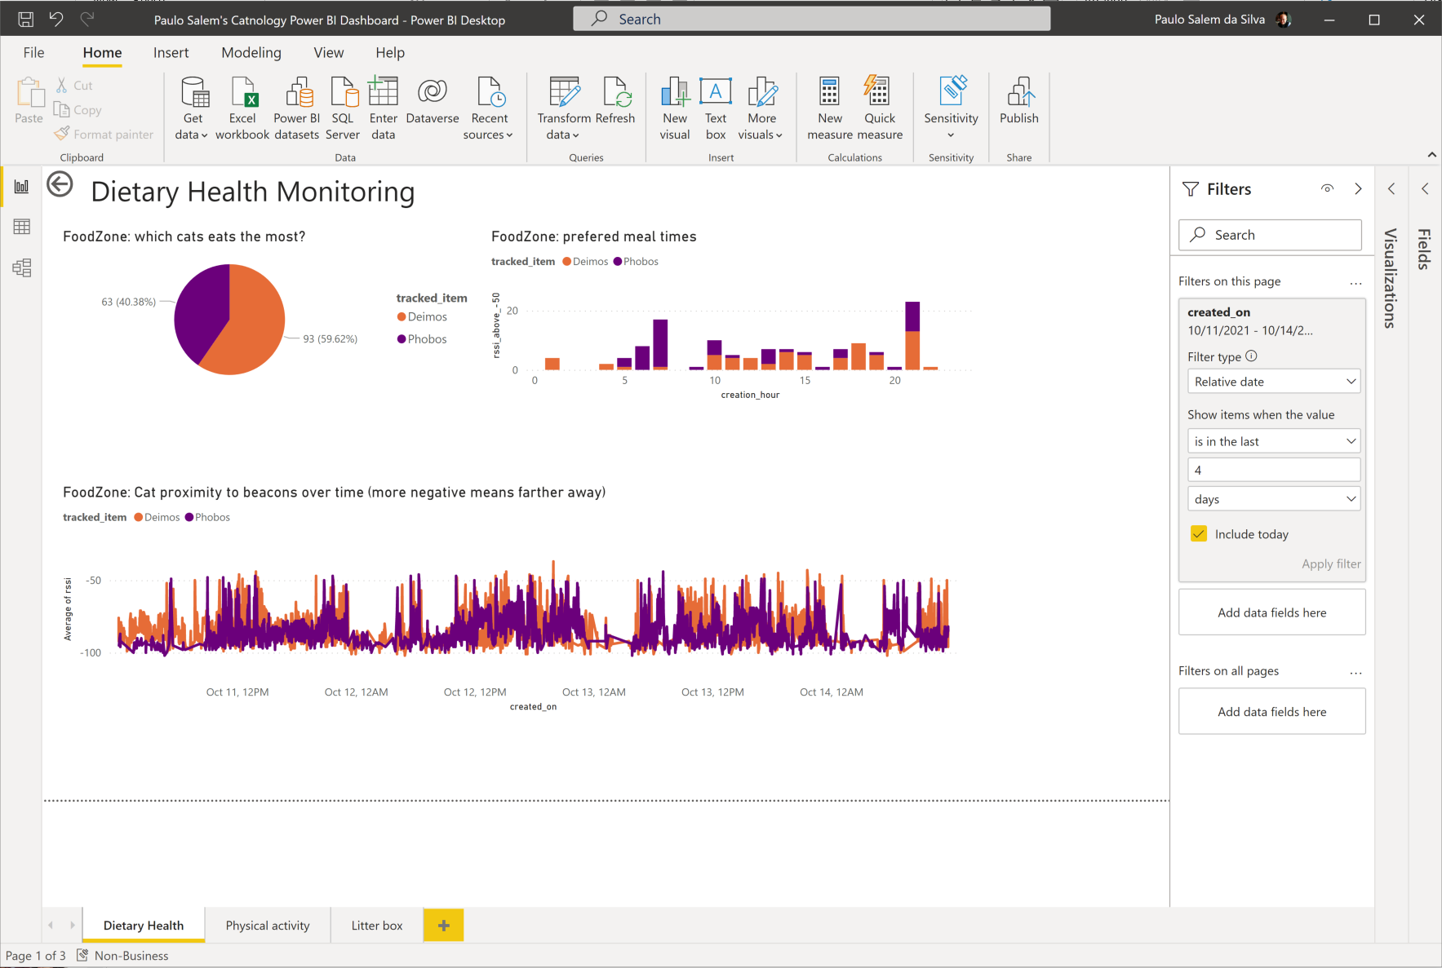

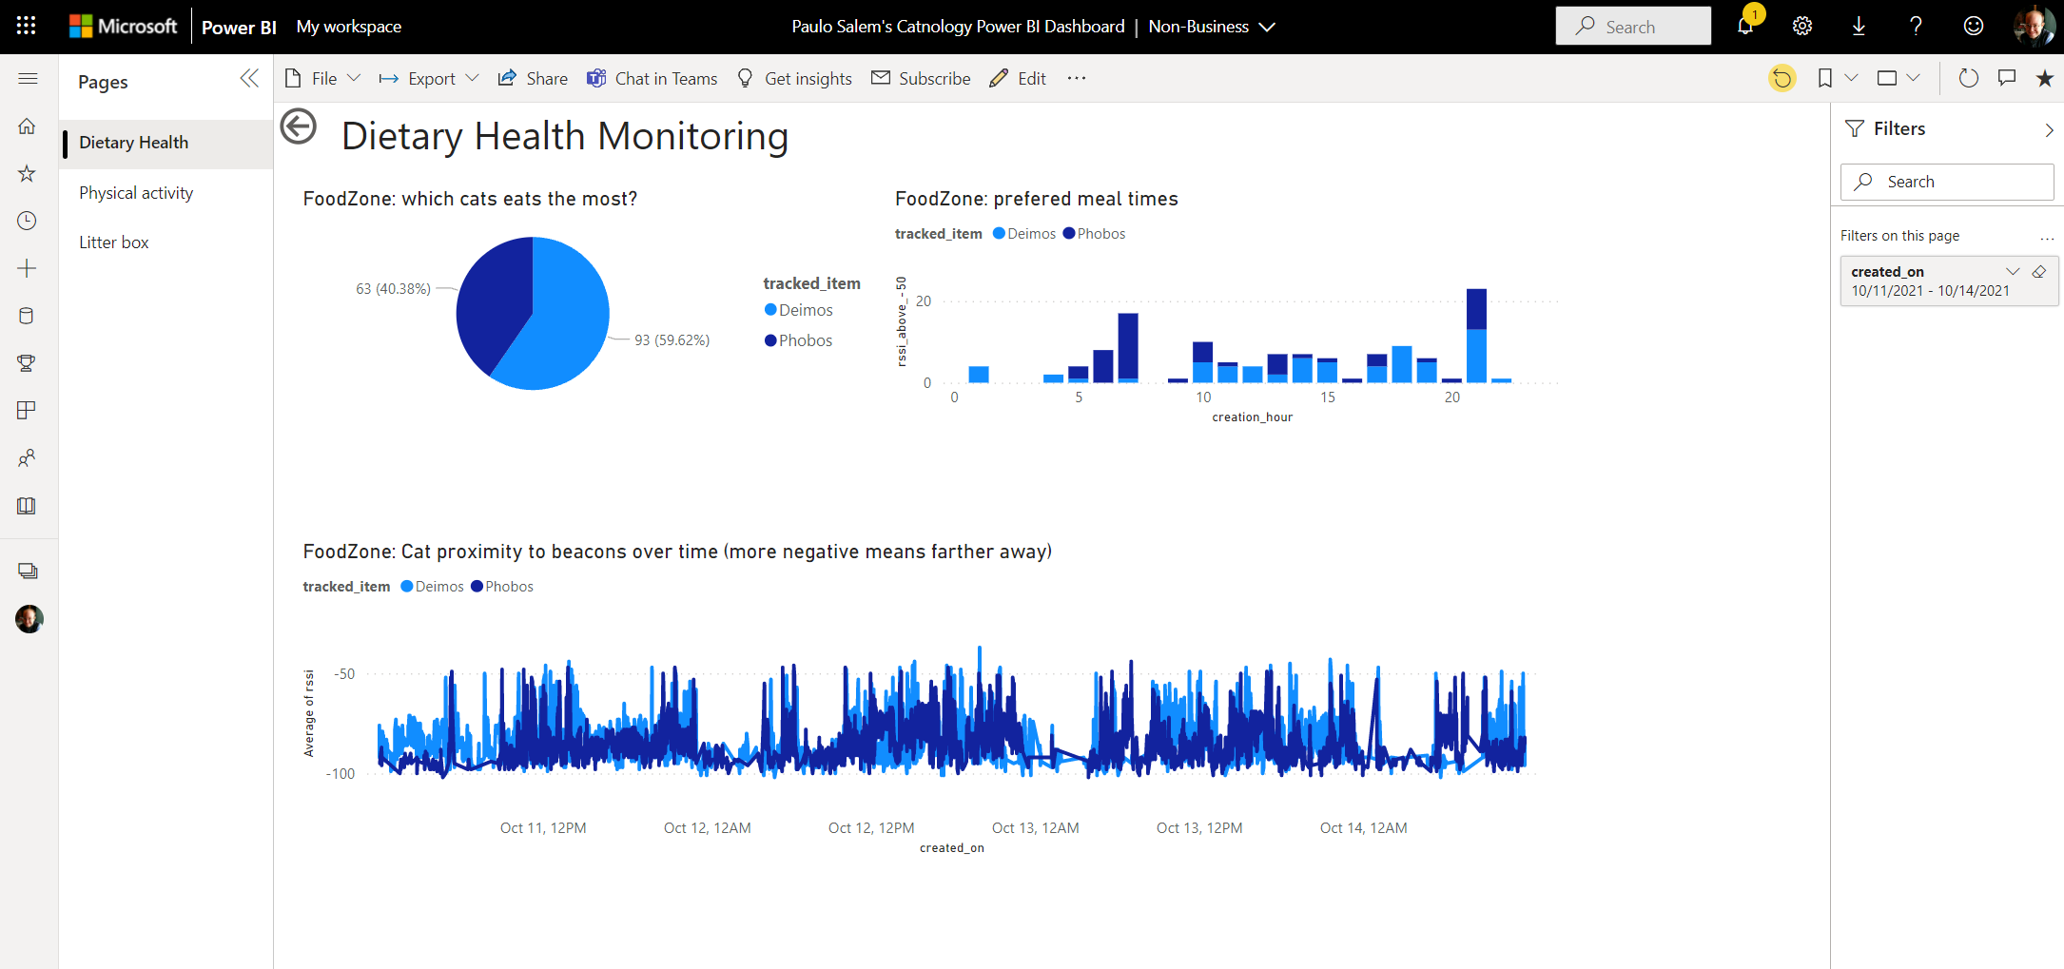

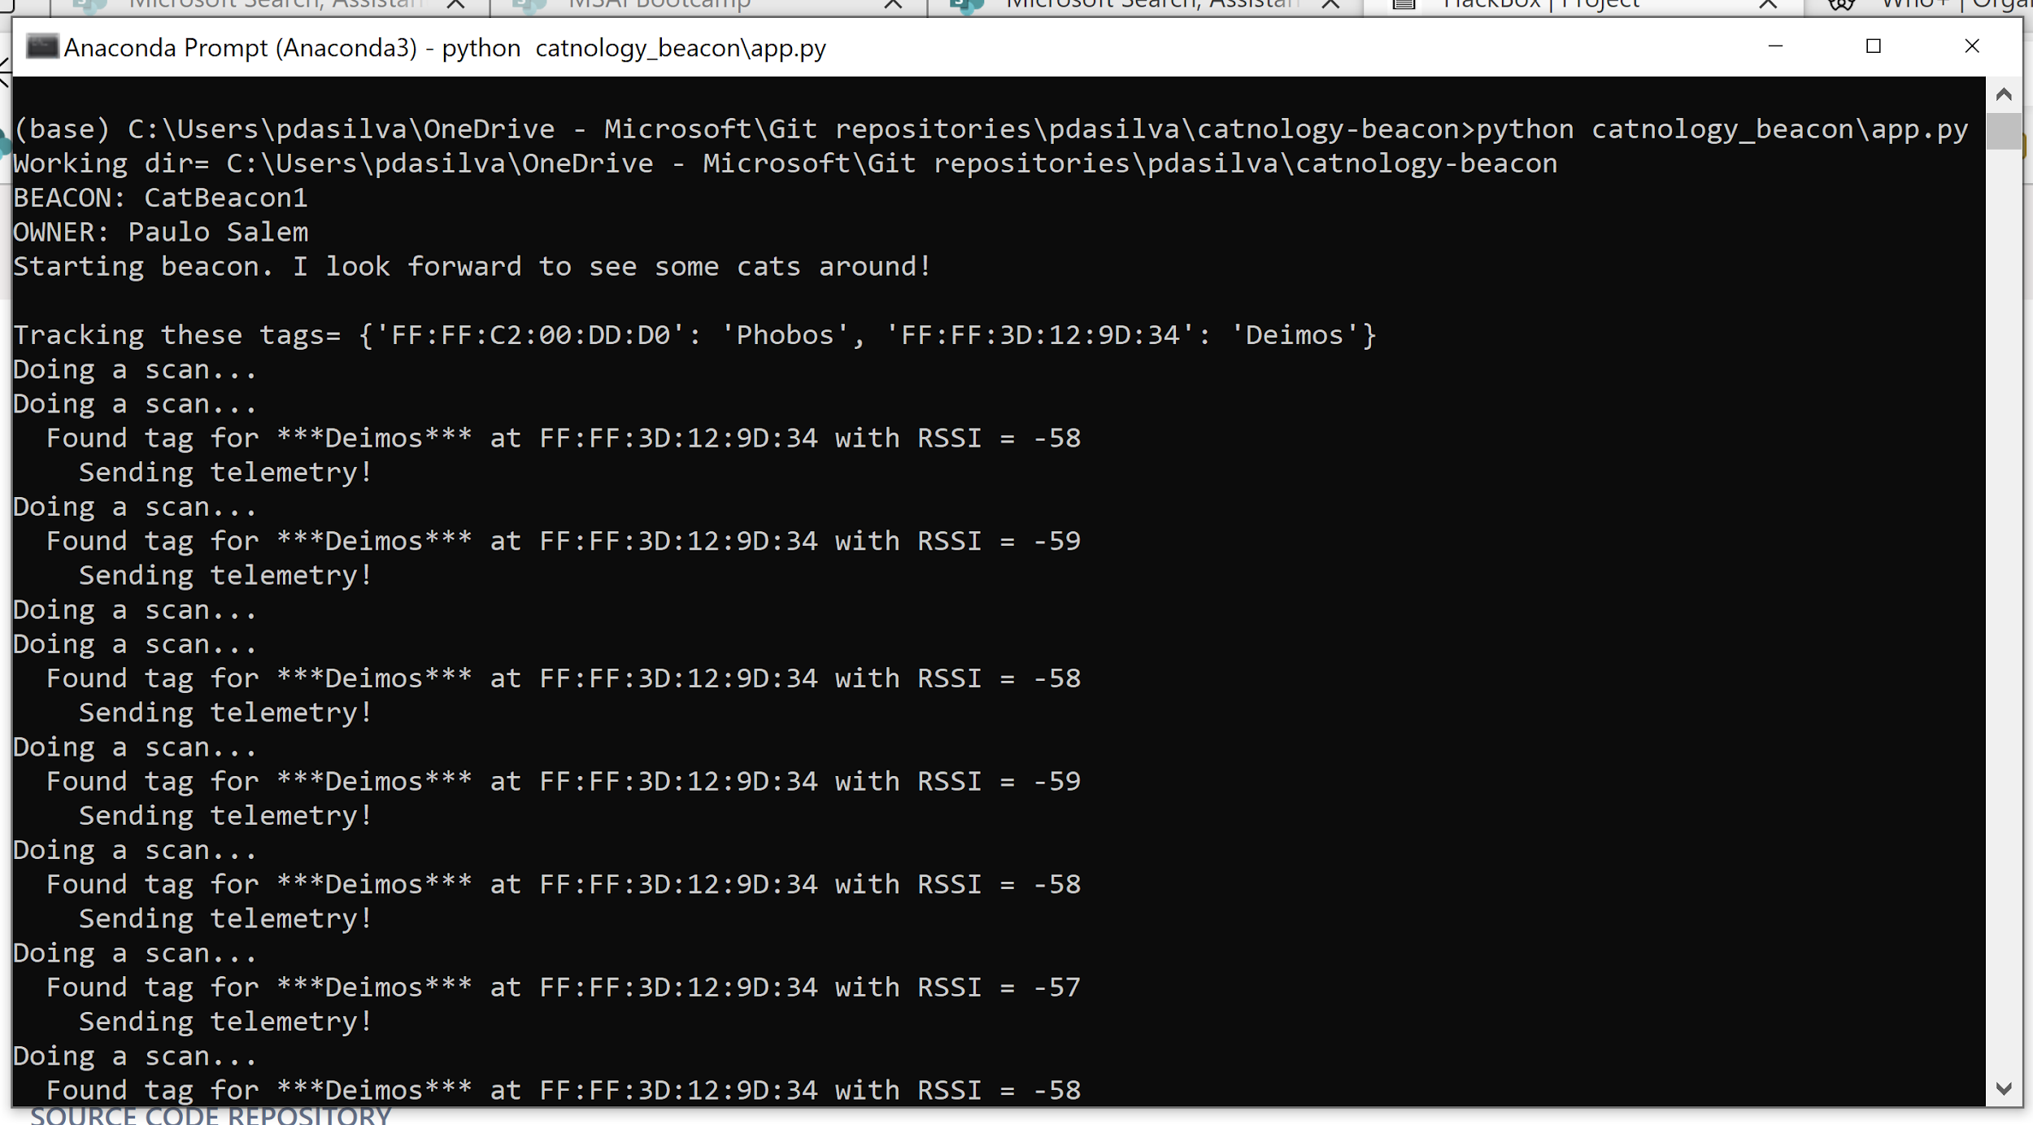
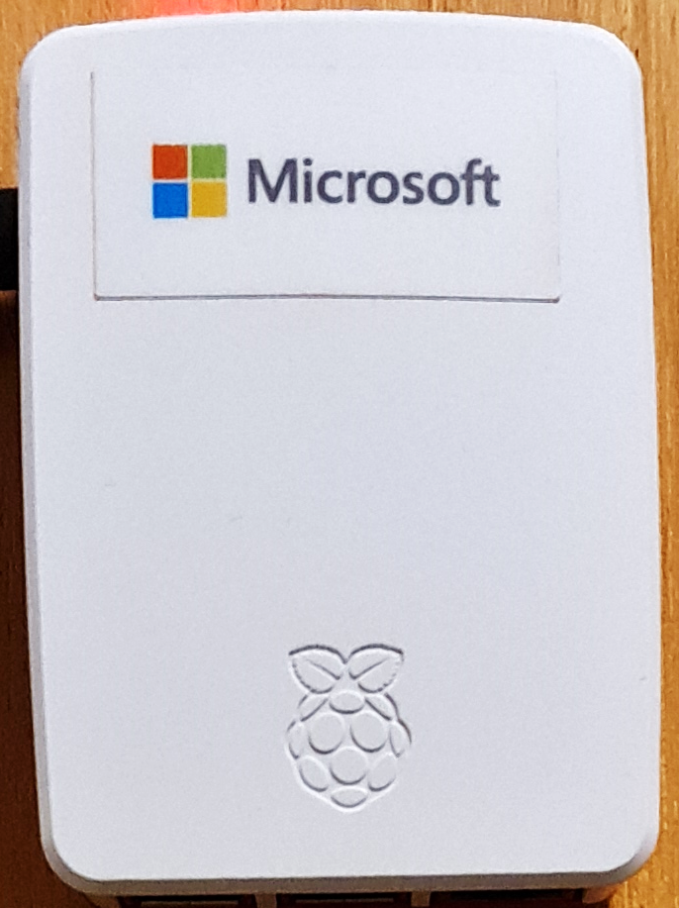

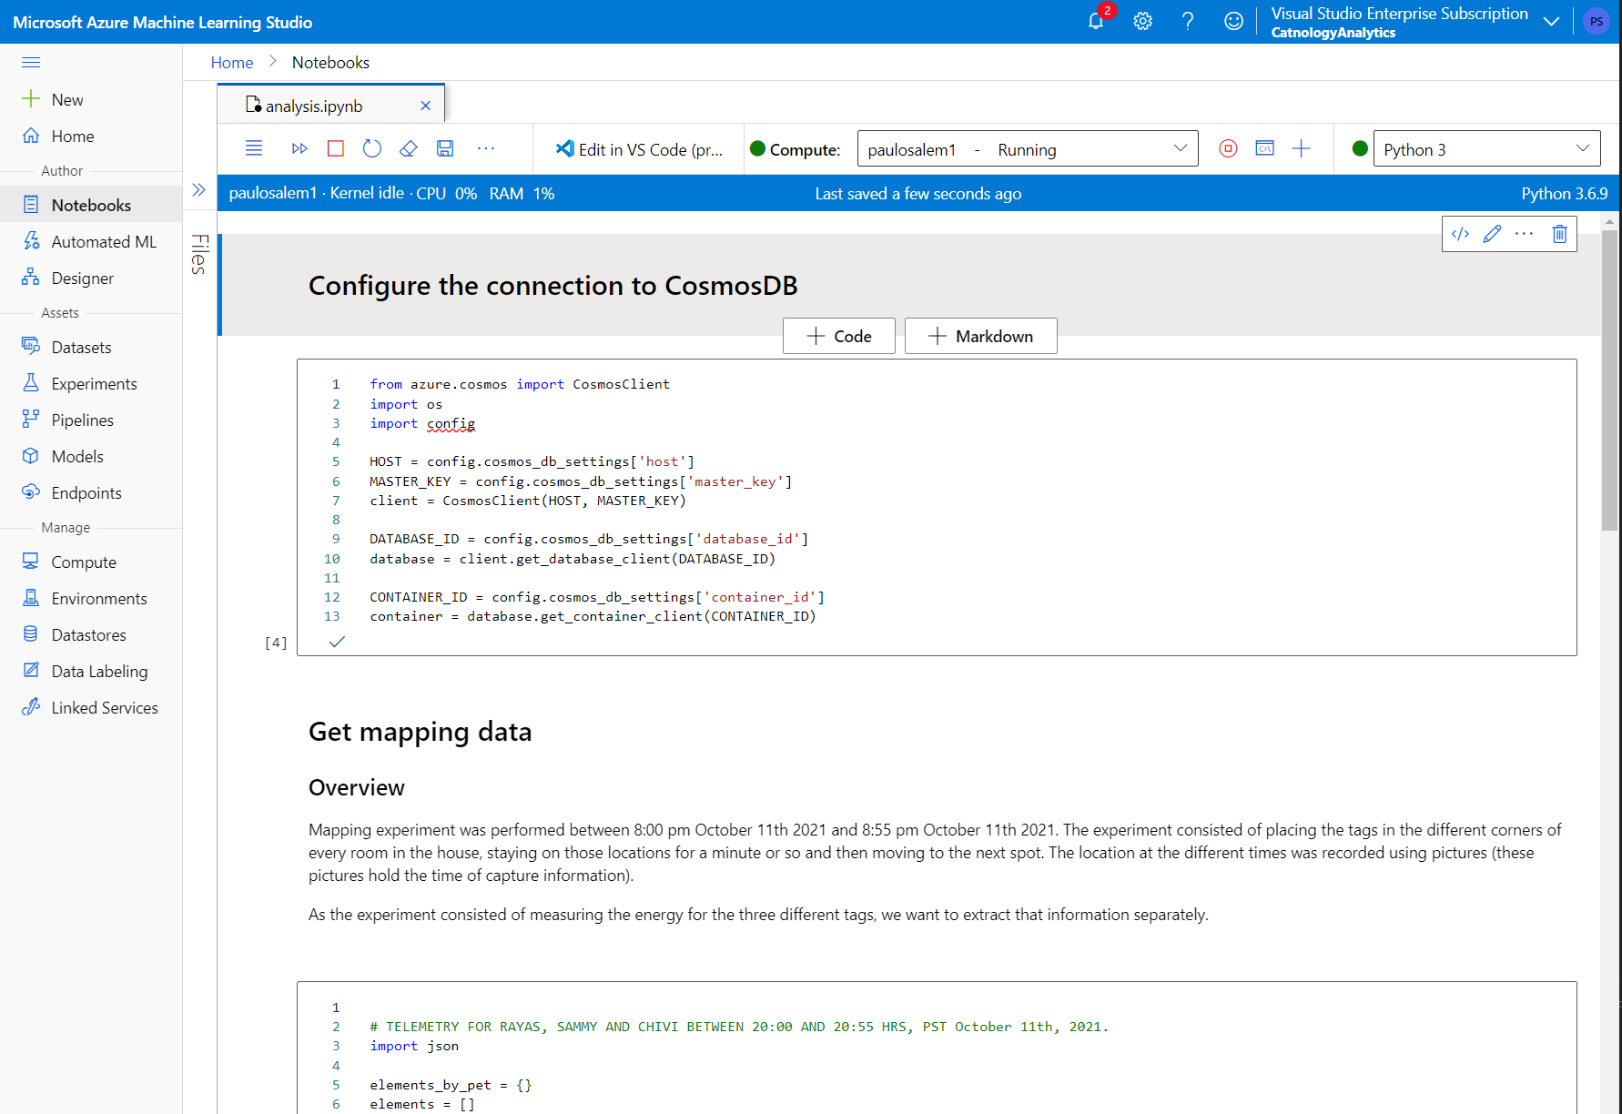
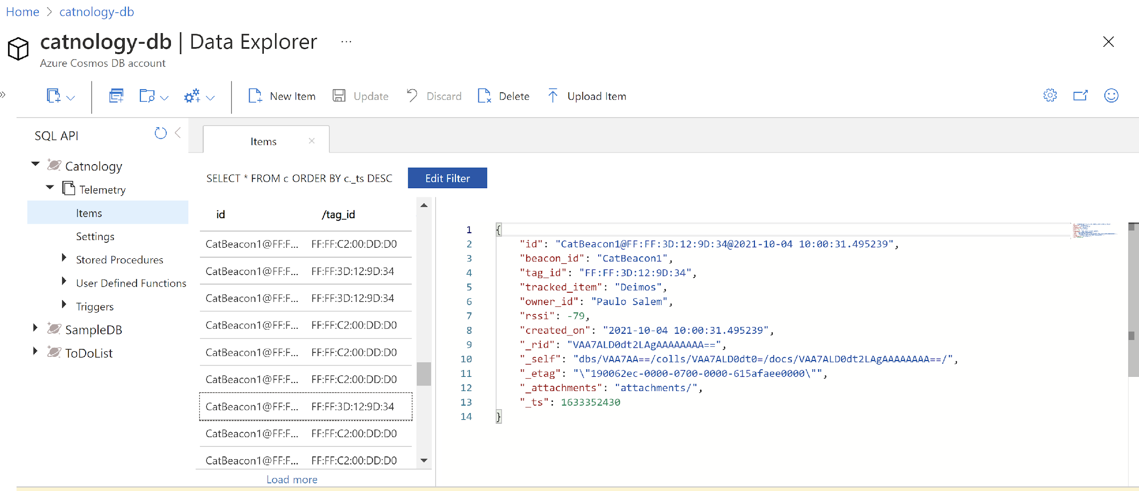

Take my money! Solution overview.
All source code is available, including setup tips
Beacon: catnology-beacon - Repos (visualstudio.com)
Analytics: catnology-analytics - Repos (visualstudio.com)
Deliverables: Beacon for data collection
Deliverables: Analytics
Tag in cat’s collar
Power BI Dashboards
Bluetooth LE tags are attached to cat’s collars. Don’t let them hanging!
Power BI Desktop can consume Cosmos DB data. Then we can publish it online (see one of our examples here). Great to visualize the data and get insights quickly – even as a team.
Beacon in Raspberry Pi
Our beacon software runs in Raspberry Pi mini-computers or on Windows (for development). It keeps listening for the specific Bluetooth tags you configured it for.
Azure
Machine Learning
Azure Cosmos DB
For more power, we went to Azure ML, where we used Jupyter notebooks for deeper investigations with Python.
All telemetry data is sent to a Cosmos DB container, where it can be accessed by any analytics tool.

Slide 16
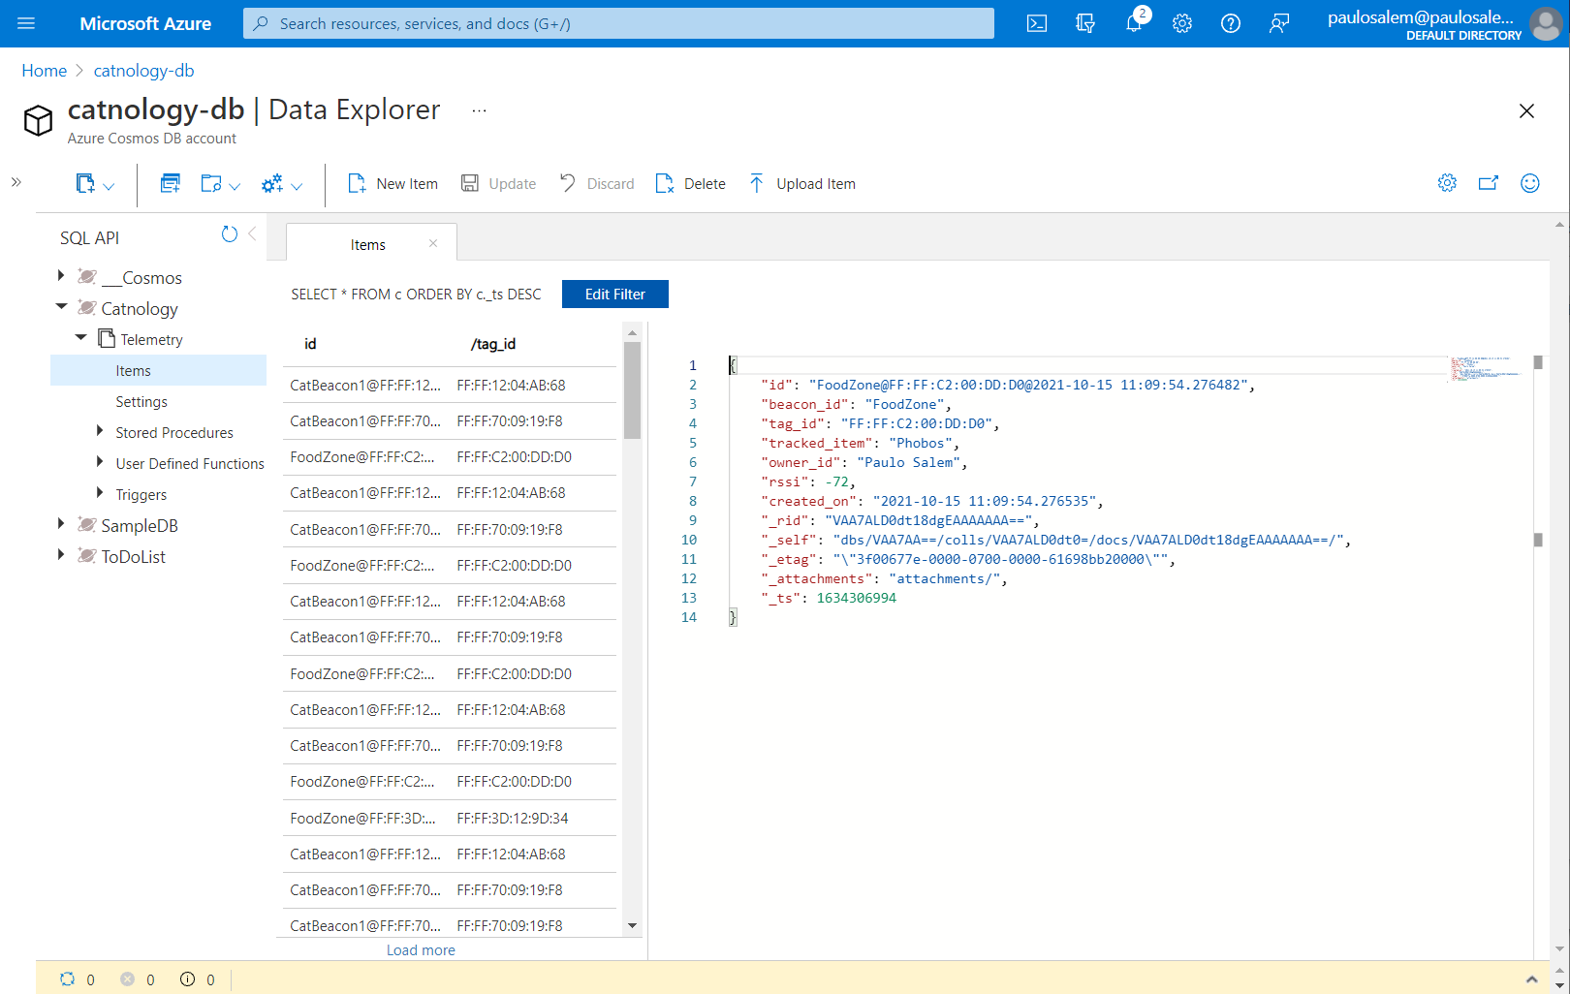
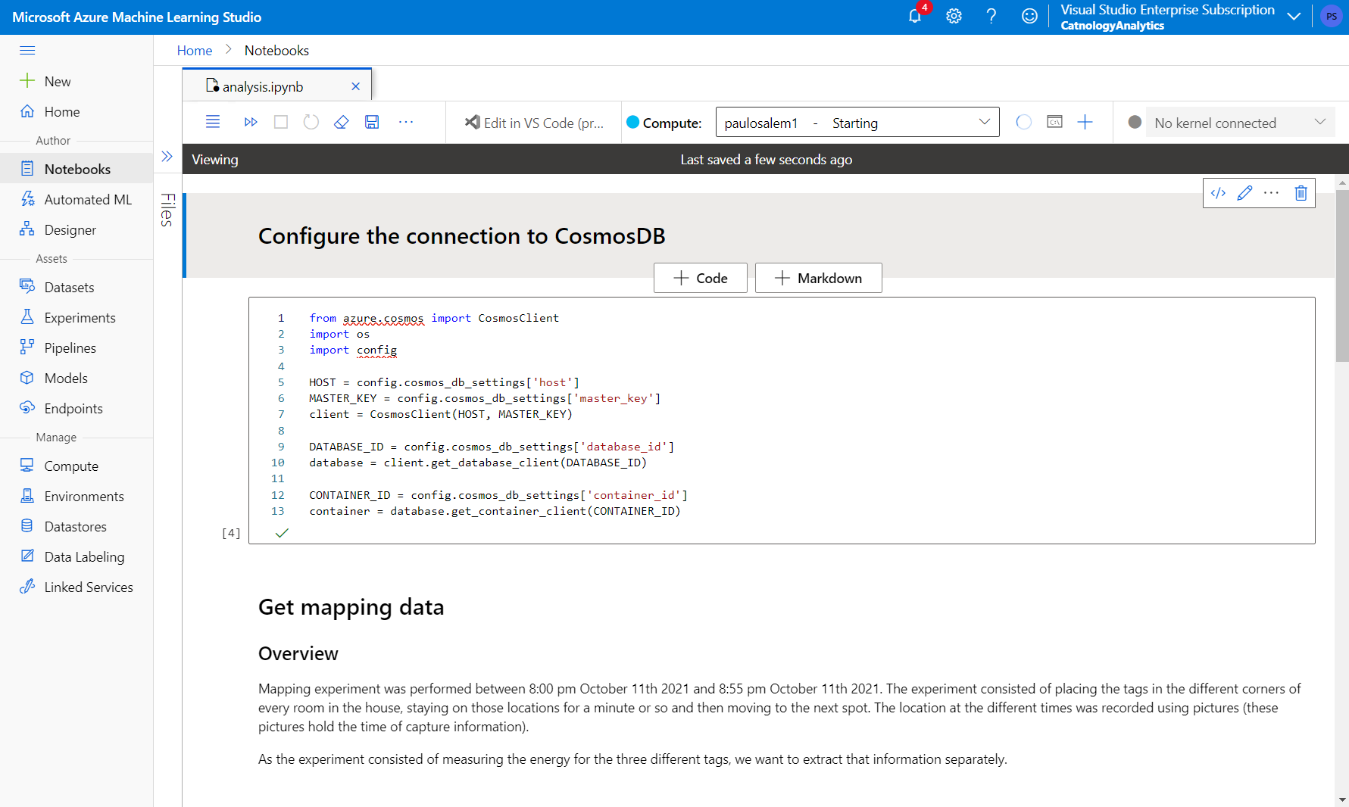
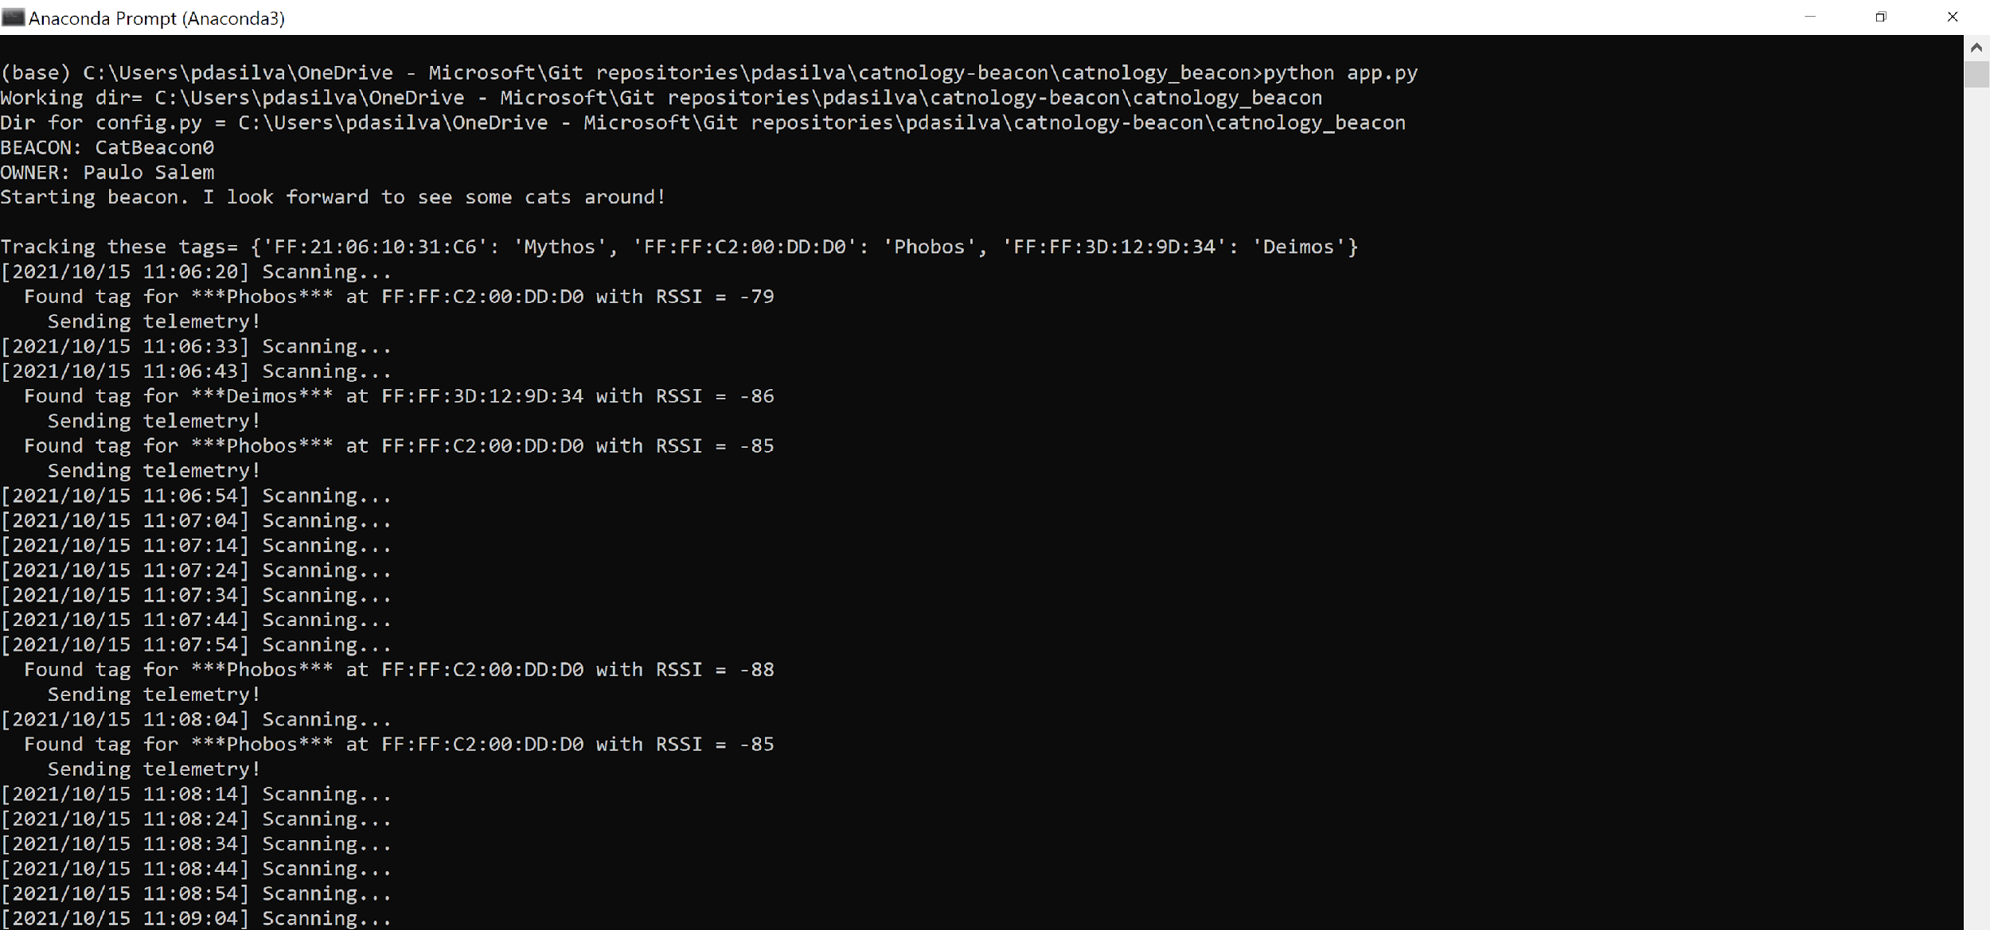
… read data from Azure ML and other analytics software.
Send data to Cosmos DB…

Slide 17
Insights
Some insights we got during the short experiments we performed.

Slide 18
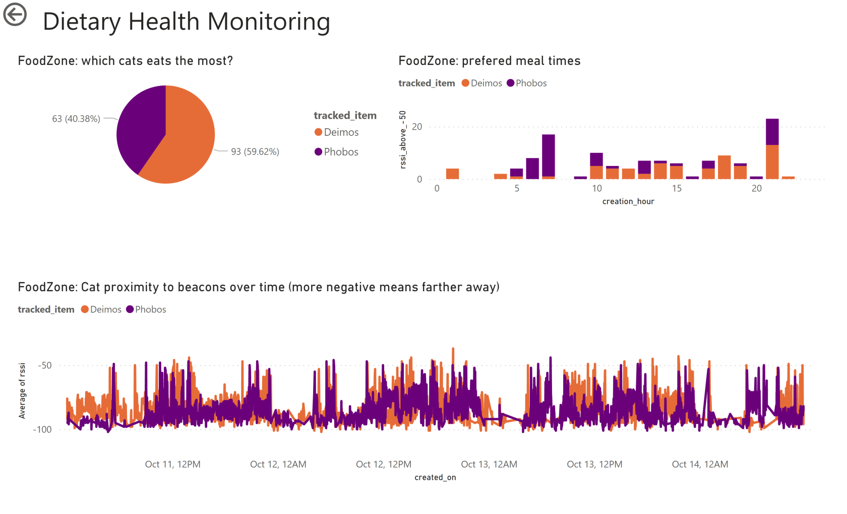
Dietary Health: eating too little?
2. Well, it seems that Phobos eats a lot at once, while Deimos eats a little bit all day long.
1. Deimos always seems to eat less. But the data seems to tell me otherwise. What is going on?
One of the Power BI dashboards.

Slide 19
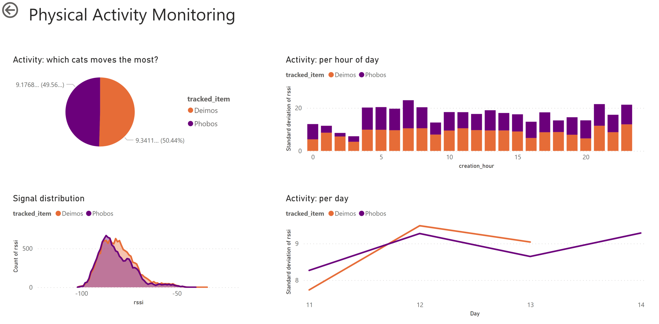
Physical activity: moving too much?
2. Though each cat prefers different times to move!
1. Deimos feels a lot more energetic. But is he really moving around more? The overall standard deviations are quite similar.
4. And here’s some apparent correlation on a daily basis!
3. And the signal distributions do show some differences – Deimos likes to stay closer to the food zone.
One of the Power BI dashboards.

Slide 20
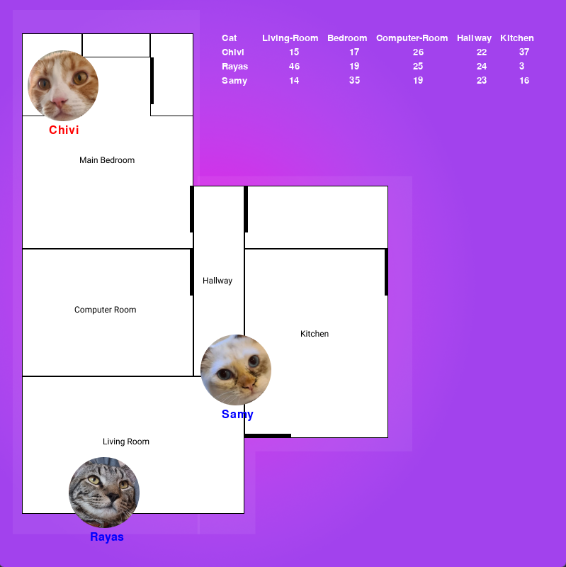
Where are my cats during the day?
2. Chivi moves around a lot, he traverses the house more than the rest
1. Sammy spends more time in the Main Bedroom and in the Kitchen, where the food is located.
3. Rayas spends most of his time in the Living Room, he eats way less than the rest of the cats.

Slide 21
That’s Life
Challenges and hiccups across the continent.

Slide 22
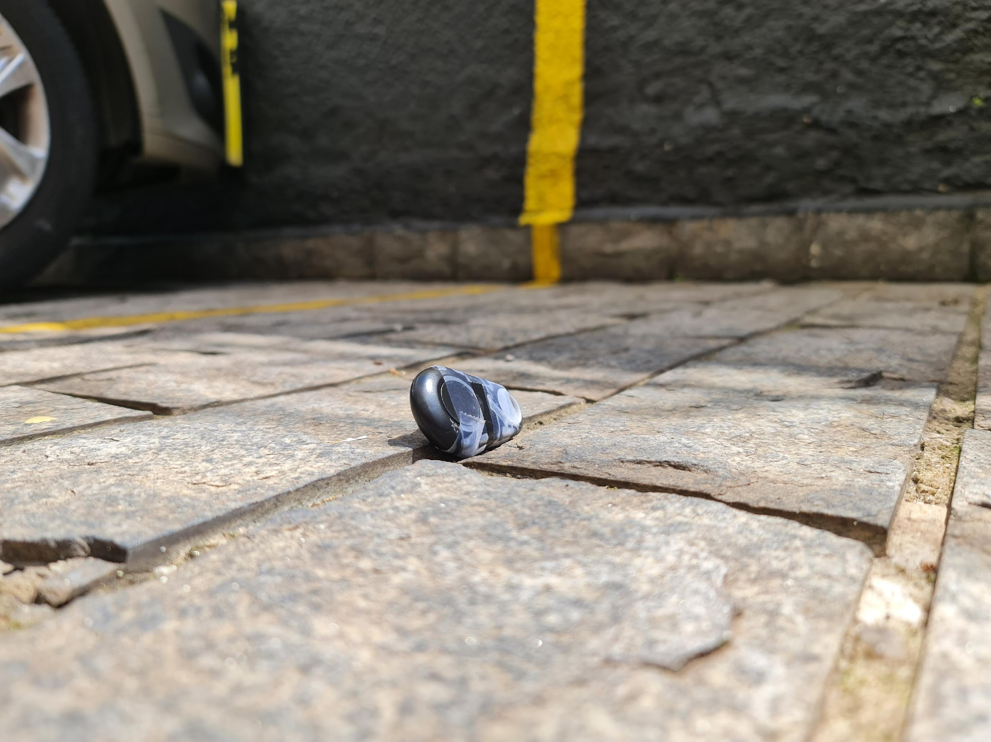
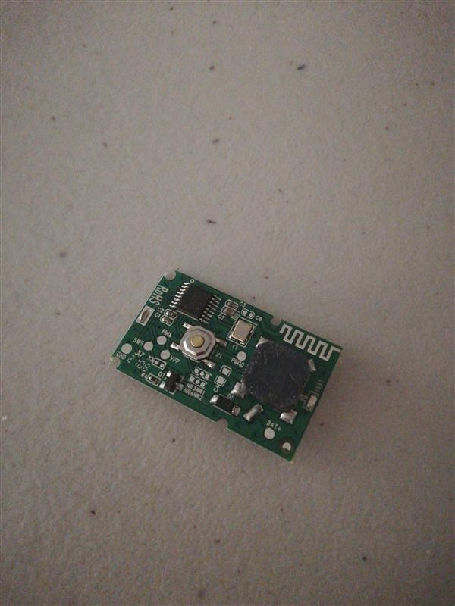
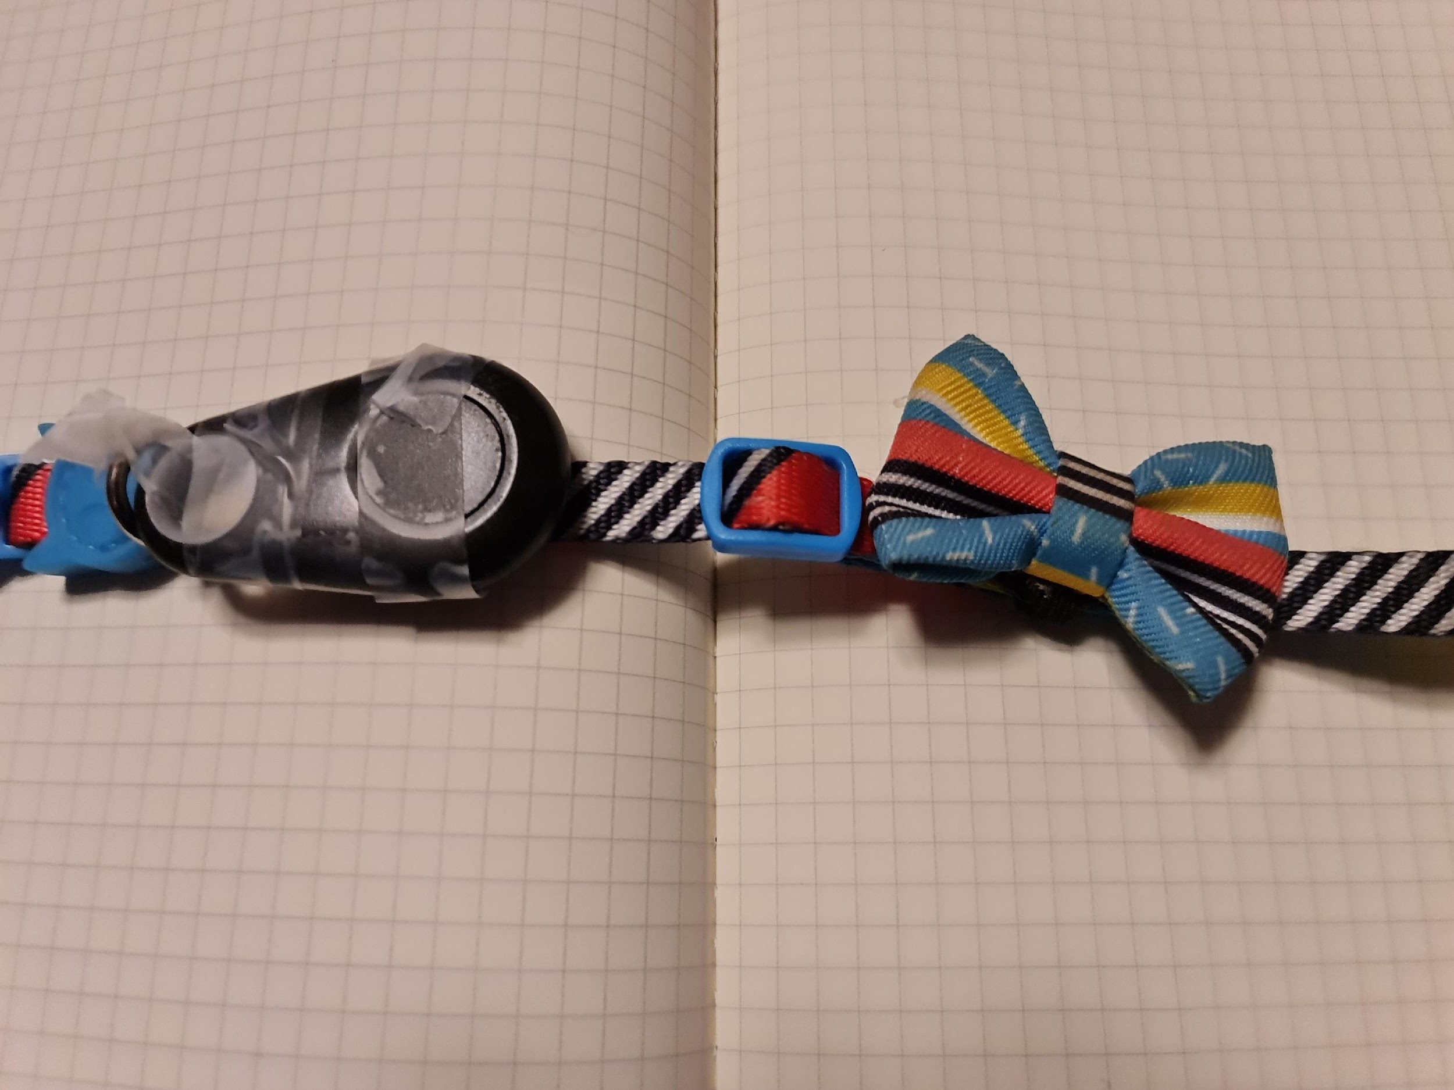
One of the Mexican cats also managed to remove a tag, and actually break it.
One of the Brazilian cats managed to remove the tag from his collar and drop it from the 6th floor. Amazingly, not only I found it, but it did not break!
Fix that tag securely, otherwise it might go missing!

Slide 23

Proyecto 1: Produciendo nuestro dataset

Slide 24
¿Qué tipo de proyecto queremos desarrollar?
Texto - Construir un detector de spam.
Ideas alternas (son solo de plantilla):
Voz - Detectar si la voz de una persona es hombre o mujer.
Imagen - Detectar si una imagen contiene a una mascota o no.

Slide 25
Entendimiento del negocio
 | DICIEMBRE
 | S1 |  | S2
ETAPAS | 7 | 9 | 14 | 16
Business Understanding
Determine Business Objectives
Background
Business Objectives
Business Success Criteria
Assess the Current Situation
Inventory of resources
Requirements, assumptions and constraints
Risks and contingencies
Terminology
Costs and benefits
Determine Data Mining Goals
Data Mining Goals
Data Mining Success Criteria
Produce Project Plan
Project Plan
Initial Assessment of Tools and Techniques

Slide 26
Entendimiento de los datos
Data Understanding
Collect Initial Data
Initial Data Collection Report
Describe Data
Initial Data Exploration
Verify Data Quality
Missing Data
Outliers
Data Quality Report

Slide 27
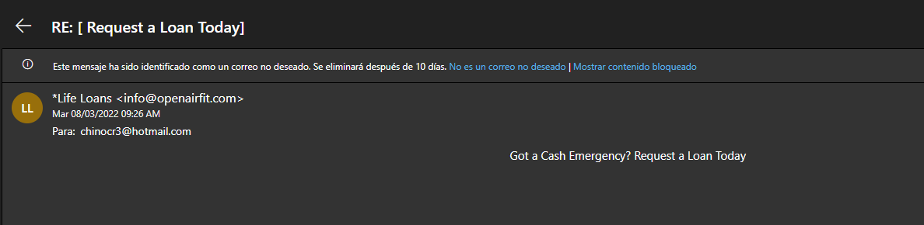
SPAM
Titulo: RE: [ Request a Loan Today]
Remitente: *Life Loans <info@openairfit.com>
Hora y fecha: 08/03/2022 9:26AM
Cuerpo:
Got a Cash Emergency? Request a Loan Today.

Slide 28
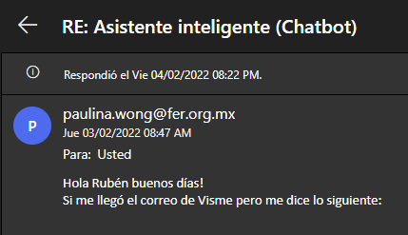
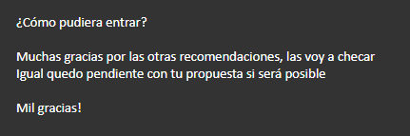
NO SPAM
Titulo: RE: Asistente inteligente (Chatbot)
Remitente: paulina.wong@fer.org.mx
Hora y fecha: 04/02/2022 08:22 PM
Cuerpo:
Hola Rubén buenos días! Si me llegó el correo de Visme pero me dice lo siguiente: ¿Cómo pudiera entrar? Muchas gracias por las otras recomendaciones, las voy a checar. Igual quedo pendiente con tu propuesta si será posible Mil gracias!

Slide 29
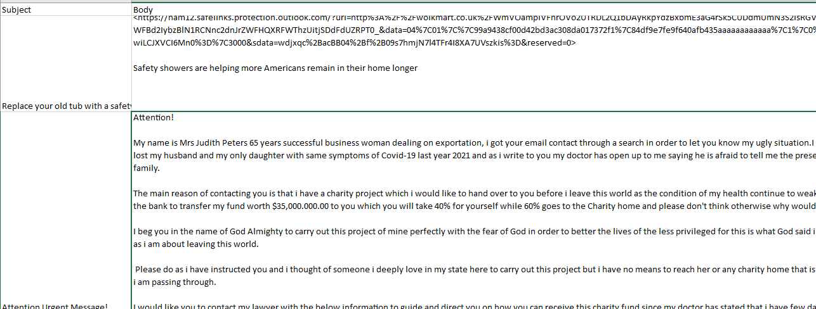
Exploremos los datos

Slide 30
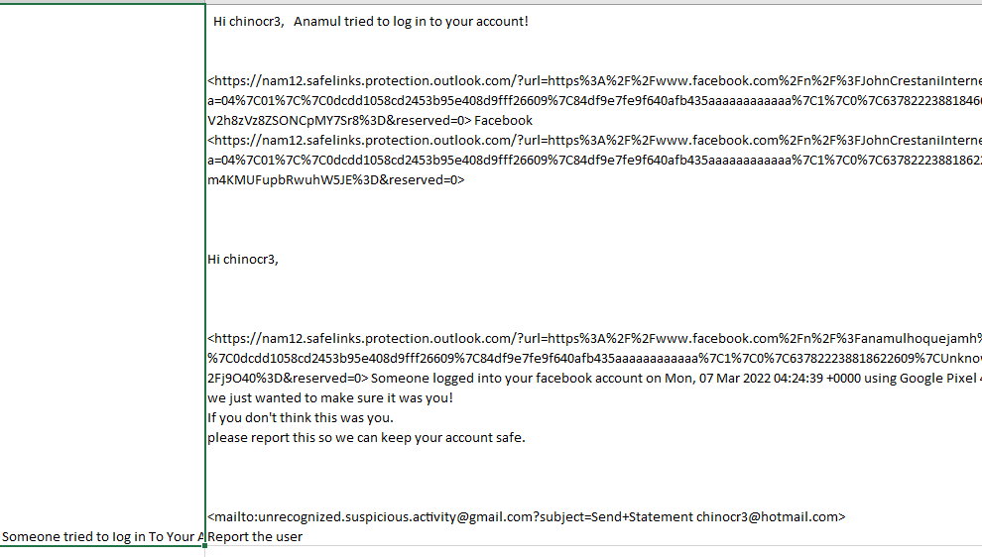

Slide 31
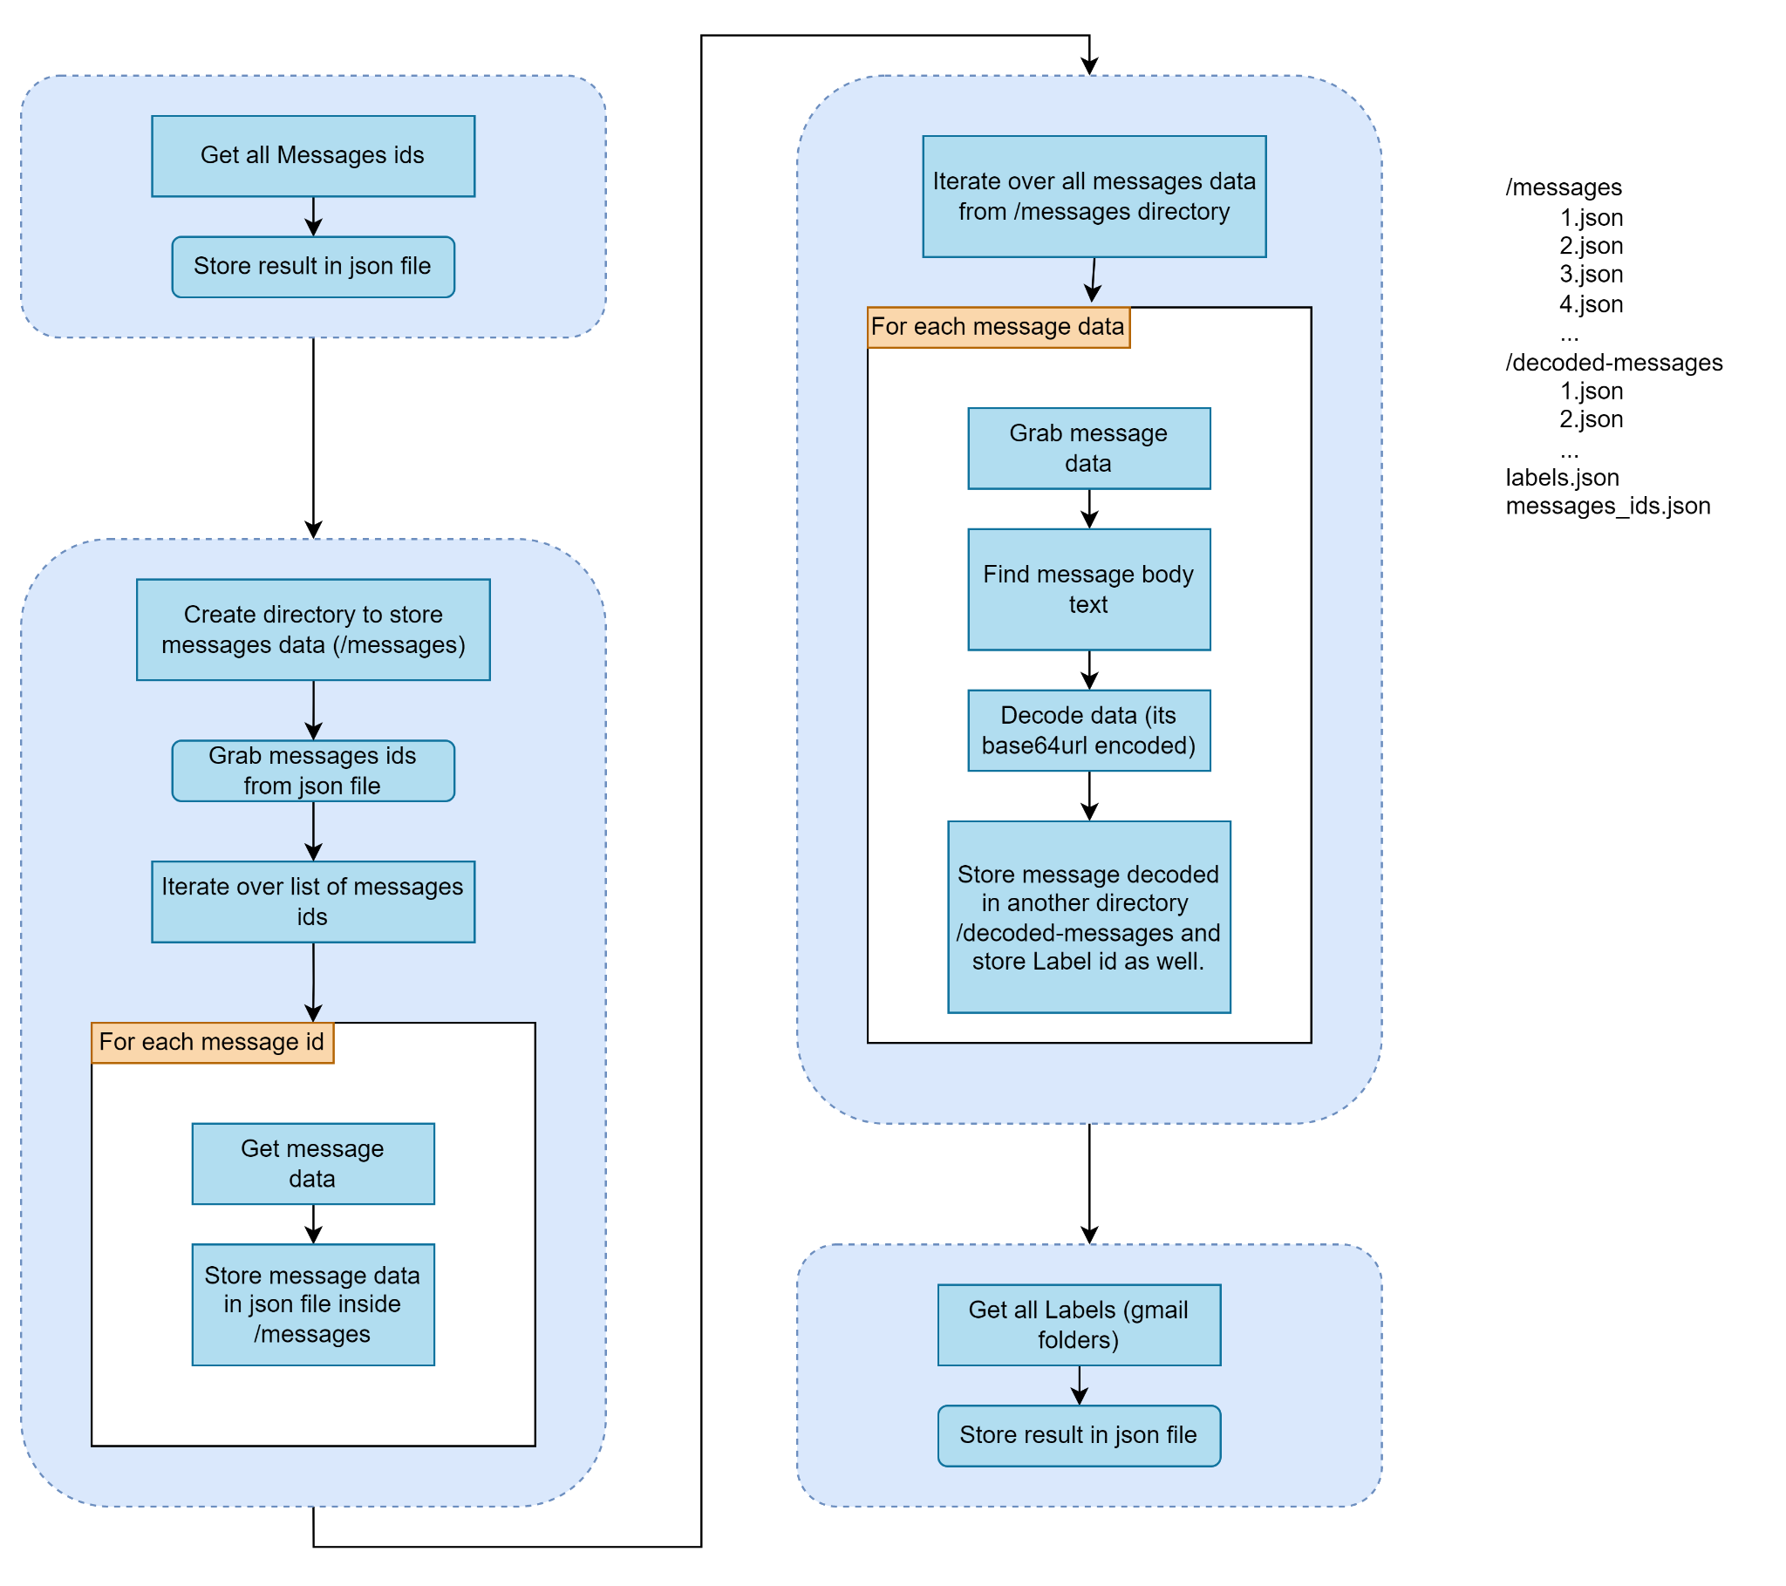

Slide 32
Descargando mis correos de Gmail
Best Python Formatter and Beautifier (codebeautify.org)
Base64 Decoding in Python | Base64Decoder
https://googleapis.github.io/google-api-python-client/docs/dyn/gmail_v1.users.messages.html
Python Quickstart | Gmail API | Google Developers
Diagrams.net
Usage limits | Gmail API | Google Developers
https://console.cloud.google.com/
RubenAMtz/scrapping_gmail: Simple toolbox to scrap Gmail messages (github.com)
https://stackoverflow.com/questions/55798776/login-in-google-colab-with-oauth2

Slide 33
Lista de cosas a considerar cuando limpiemos la data
Links
Imágenes
Código HTML
¿Algo más?

Slide 34
Recursos para tratamiento de texto
email - Read a big .mbox file with Python - Stack Overflow
A Guide To Cleaning Text in Python | by Kurtis Pykes | Towards Data Science
Efficiently Cleaning Text with Pandas - Practical Business Python (pbpython.com)

Slide 35
Notebook
Vamos a colaborar!

Slide 36

Q & A

Slide 37
Como descargar mis correos
Gmail:
How to download your Google data - Google Account Help
https://takeout.google.com/
Hotmail:
https://helpdeskgeek.com/office-tips/how-to-export-your-e-mails-from-outlook-to-csv-pst/

Slide 38

Módulo IX: Proyectos de Machine Learning.

